Slide 1
Capstone Project:
Analytical CRM Development for a Bank

Slide 2

Agenda
Problem Statement
Data Description
Objective Key Metrics and Visualizations
Subjective Question for Insights

Slide 3
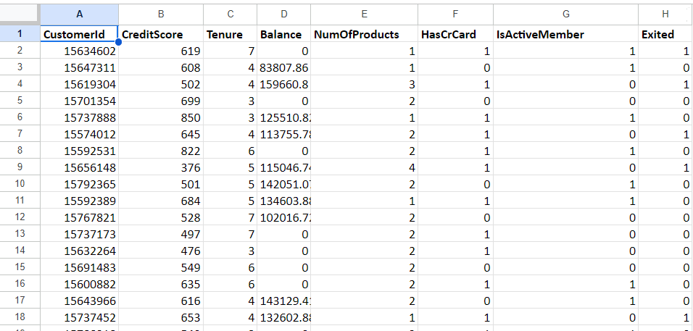
Problem Statement
You are an analytical CRM (Customer Relationship Management) specialist hired by a bank to extract meaningful insights from various customer-related datasets. The bank aims to reduce customer churn, improve service delivery, and enhance customer satisfaction. They have provided you with datasets including customer demographics, transaction details, customer exit information, and active customer profiles.

Slide 4
The image above displays details about Bank Customer data, including:
RowNumber: The row number in the dataset, likely used for reference or indexing.
CustomerId: A unique identifier for each customer.
CreditScore: A numerical representation of the customer's creditworthiness.
Credit score:
Excellent: 800–850
Very Good: 740–799
Good: 670–739
Fair: 580–669
Poor: 300–579
GeographyID: A numerical identifier that likely corresponds to a geographical location, such as a country or region.
GenderID: A numerical identifier for the customer's gender, where for example, '1' could represent male and '2' could represent female.

Slide 5
The image above displays details about bank customer data, including: (Cont..)
Age: The age of the customer.
Tenure: The number of years the customer has been with the bank.
Balance: Current balance in the customer's account.
NumOfProducts: refers to the number of products that a customer has purchased through the bank.
HasCrCard: denotes whether or not a customer has a credit card. This column is also relevant, since people with a credit card are less likely to leave the bank.
1 represents credit card holder
0 represents non credit card holder

Slide 6
The image above displays details about bank customer data, including: (Cont..)
IsActiveMember: active customers are less likely to leave the bank (as per the criteria defined by the bank for identifying the activeness).
1 represents Active Member
0 represents Inactive Member
Estimated Salary: as with balance, people with lower salaries are more likely to leave the bank compared to those with higher salaries.
Exited: whether or not the customer left the bank.
0 represents Retain
1 represents Exit
Bank DOJ: date when the Customer associated/joined with the bank.

Slide 7

Use this Link for copying and then manipulating the dataset.

Slide 8
Submission
There is a series of tasks/questions mentioned ahead in the Capstone Project, in order to guide the candidates to have suggestions, insights for the Analytical CRM Development for a Bank.
You are asked to present a submitted PPT file to the management for the story telling and suggestions in order to complete the objectives.
The submission Zip file should consist of the following documents:
Sql File (.sql)
Power BI File (.pbix) (consisting of dashboard)
Document File (.docx) (consisting of Answers and suggestions for Objective and subjective questions)
Presentation File (.pptx) (consisting of the presentation which you want to present to the bank)

Slide 9
Tasks
…Tasks in order to come up with suggestions

Slide 10
Pointers for Analysis
Data Consolidation and Preprocessing with Power BI/Excel:
Import the different Excel and CSV datasets into a single Excel workbook.
Perform data cleaning to resolve inconsistencies and missing values.
2. Data Storage and Manipulation with SQL:
Import the unified Excel data into a SQL database.
Analyze customer churn by writing SQL queries to correlate customer attributes with churn rates.

Slide 11
Pointers for Analysis
3. Data Analysis and Visualization with Power BI:
Use the Queries Output and the original files to process data in PowerBI.
Develop interactive dashboards to display customer segmentation, churn rates, and credit card usage.
4. Objectives to Achieve with the Analysis
a. Determine the key factors contributing to customer churn.
b. Identify profitable customer segments and target them with tailored services.

Slide 12
Objective Questions
What is the distribution of account balance across different regions?
Identify the top 5 customers with the highest Estimated Salary in the last quarter of the year. (SQL)
Calculate the average number of products used by customers who have a credit card. (SQL)
Determine the churn rate by gender for the most recent year in the dataset.
Compare the average credit score of customers who have exited and those who remain. (SQL)
Which gender has a higher average estimated salary, and how does it relate to the number of active accounts? (SQL)
Segment the customers based on their credit score and identify the segment with the highest exit rate. (SQL)

Slide 13
Objective Questions (Cont..)
8. Find out which geographic region has the highest number of active customers with a tenure greater than 5 years. (SQL)
9. What is the impact of having a credit card on customer churn, based on the available data?
10. For customers who have exited, what is the most common number of products they had used?
11. Examine the trend of customer joining over time and identify any seasonal patterns (yearly or monthly). Prepare the data through SQL and then visualize it.
12. Analyze the relationship between the number of products and the account balance for customers who have exited.
13. Identify any potential outliers in terms of balance among customers who have remained with the bank.

Slide 14
Objective Questions (Cont..)
14. How many different tables are given in the dataset, out of these tables which table only consist of categorical variables?
15. Using SQL, write a query to find out the gender wise average income of male and female in each geography id. Also rank the gender according to the average value. (SQL)
16. Using SQL, write a query to find out the average tenure of the people who have exited in each age bracket (18-30, 30-50, 50+).
17. Is there any direct correlation between salary and balance of the customers? And is it different for people who have exited or not?
18. Is there any correlation between salary and Credit score of customers?
19. Rank each bucket of credit score as per the number of customers who have churned the bank.
20. According to the age buckets find the number of customers who have a credit card. Also retrieve those buckets who have lesser than average number of credit cards per bucket.

Slide 15
Objective Questions (Cont..)
21. Rank the Locations as per the number of people who have churned the bank and average balance of the learners.
22. As we can see that the “CustomerInfo” table has the CustomerID and Surname, now if we have to join it with a table where the primary key is also a combination of CustomerID and Surname, come up with a column where the format is “CustomerID_Surname”.
23. Without using “Join”, can we get the “ExitCategory” from ExitCustomers table to Bank_Churn table? If yes do this using SQL.
24. Were there any missing values in the data, using which tool did you replace them and what are the ways to handle them?
25. Write the query to get the customer ids, their last name and whether they are active or not for the customers whose surname ends with “on”.
26. Can you observe any data disrupency in the Customer’s data? As a hint it’s present in the IsActiveMember and Exited columns. One more point to consider is that the data in the Exited Column is absolutely correct and accurate.

Slide 16
In order to answer the next data analysis questions you will have to perform the analysis mention all problem and then create Reports and visualizations to answer the questions.
For answering these questions you need to properly analyze the data through summarization, report and visualizations to give the insights. Back your suggestions/insights with proper reasoning considering the data.

Slide 17
Data Analysis and Visualizations (Subjective Questions):
Customer Behavior Analysis: What patterns can be observed in the spending habits of long-term customers compared to new customers, and what might these patterns suggest about customer loyalty?
Product Affinity Study: Which bank products or services are most commonly used together, and how might this influence cross-selling strategies?
Geographic Market Trends: How do economic indicators in different geographic regions correlate with the number of active accounts and customer churn rates?
Risk Management Assessment: Based on customer profiles, which demographic segments appear to pose the highest financial risk to the bank, and why?
Customer Lifetime Value Forecast: How would you use the available data to model and predict the lifetime (tenure) value of different customer segments?

Slide 18
Data Analysis and Visualizations (Subjective Question) - (Cont…)
6. Marketing Campaign Effectiveness: How could you assess the impact of marketing campaigns on customer retention and acquisition within the dataset? What extra information would you need to solve this?
7. Customer Exit Reasons Exploration: Can you identify common characteristics or trends among customers who have exited that could explain their reasons for leaving?
8. Are 'Tenure', 'NumOfProducts', 'IsActiveMember', and 'EstimatedSalary' important for predicting if a customer will leave the bank?
9. Utilize SQL queries to segment customers based on demographics and account details.
10. How can we create a conditional formatting setup to visually highlight customers at risk of churn and to evaluate the impact of credit card rewards on customer retention?

Slide 19
Data Analysis and Visualizations (Subjective Question) - (Cont…)
11. What is the current churn rate per year and overall as well in the bank. Can you suggest some insights to the bank about which kind of customers are more likely to churn and what are the different strategies that can be used to decrease the churn rate.
12. Create a dashboard incorporating all the KPIs and visualization related metrics. Use a slicer in order to assist in selection in the dashboard.
13. How would you approach this problem, if the objective and subjective questions weren't given?
14. In the “Bank_Churn” table how can you modify the name of “HasCrCard” column to “Has_creditcard”?

Slide 20
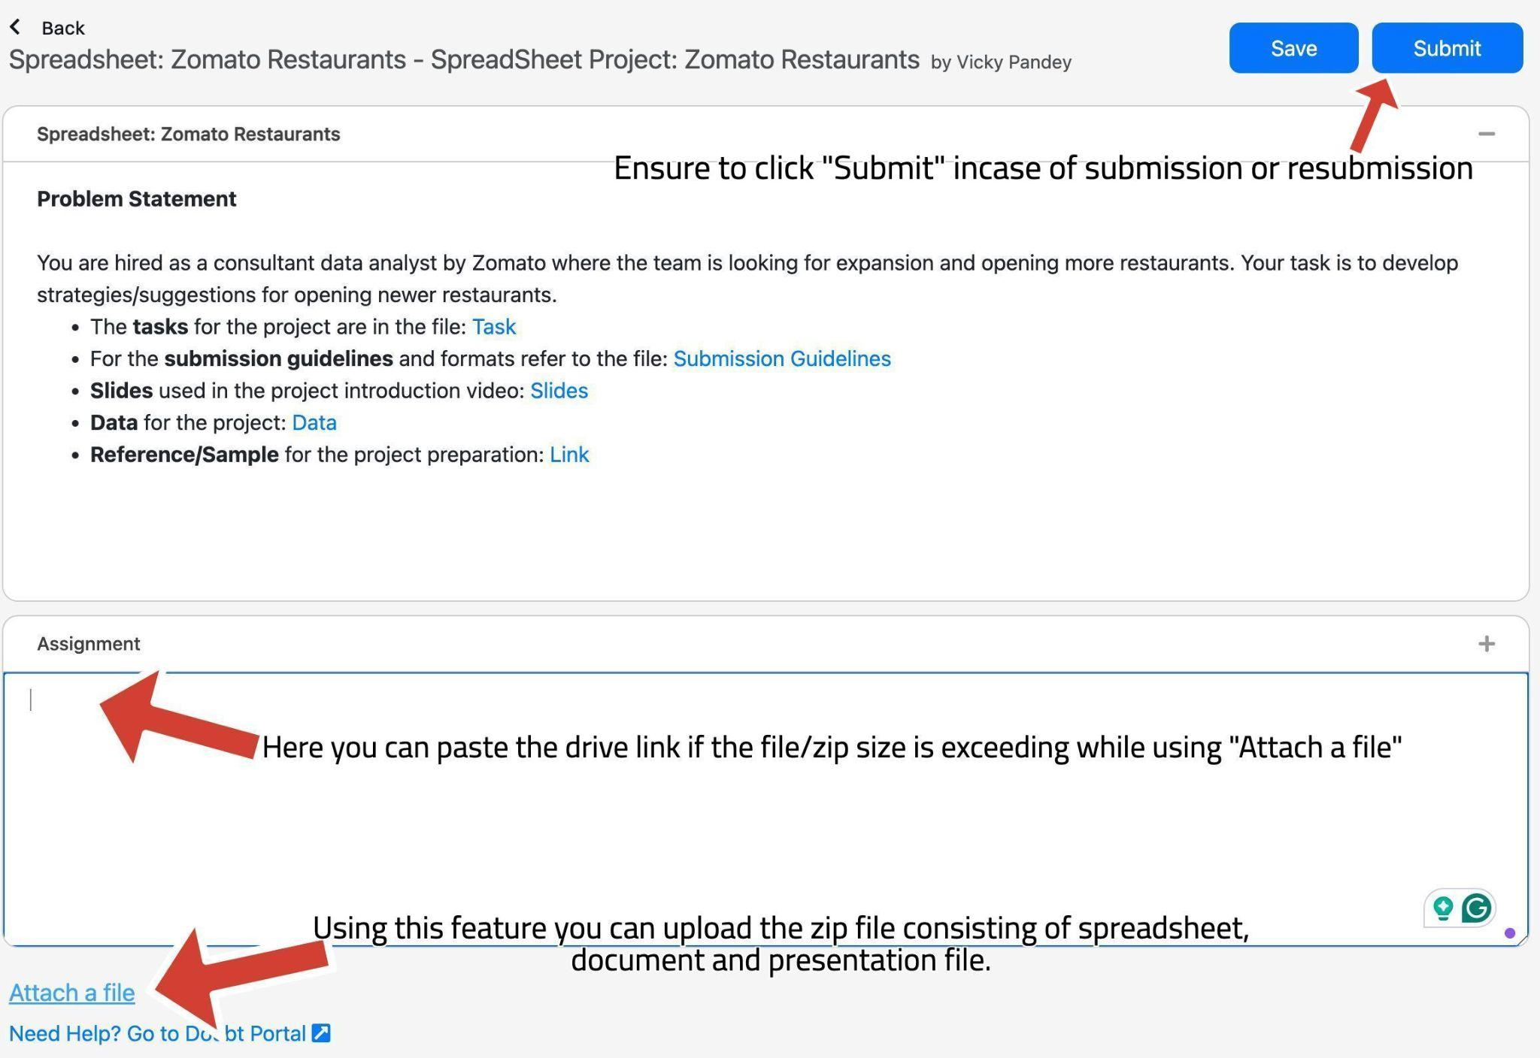
Submission UI
The submission UI can be changed a bit from the video, kindly refer here.
Look at the arrows and the comments to get familiar with the UI while submission and uploading the files on the platform. There is a space to paste the drive link and upload the zip file.

Slide 21
SUBMISSION FLOW
The candidates are supposed to submit the project within 10 days.
After the submission, candidates will receive the feedback on their project, which they are supposed to incorporate and re-submit.
All the candidates are supposed to get a total of >= 8 marks in order to be prioritized in placements. They are necessary in Placements.
The re-submissions after 3 weeks of launch in the batch will be de-prioritised while evaluations.
Candidates will have to give the reason for their delay, in order to make sure that team picks up their evaluation.
This will create backlogs as the project for next module will also be releasing around the same time.
So make sure to submit the project (with the requirements) within timeline.

Slide 22
GUIDELINES:
Ensure to submit the project within the deadline.
TA support won’t be answering any direct questions regarding project.
Plagiarism will be checked during evaluation.
Queries regarding submission should be asked to success champions.
Candidates must score >=8 out of 10 in order to be picked for referrals.

Slide 23
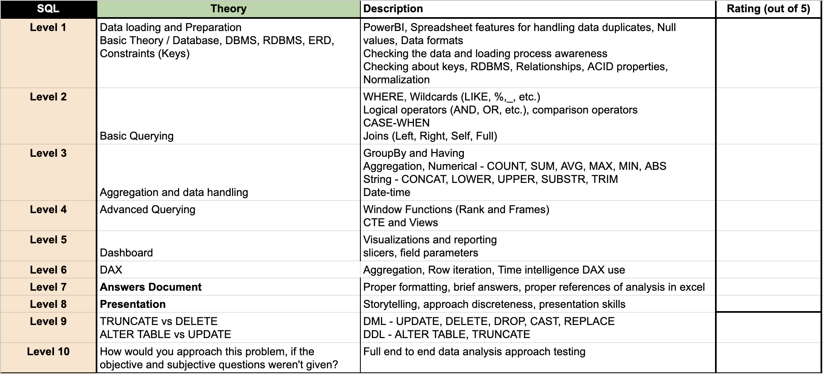
EVALUATION
The projects will be evaluated on 10 levels (Each learner will receive a detailed feedback).
On each level, learners will get a rating out of 5 and if the rating is smaller than 4, he won’t be considered as passed at that level.
Learners have to get >=4 (or passed) in at least 8 levels to get >=8 as the final rating in the project.
In the final feedback, only the final feedback out of 10 will be considered.
The ratings of level 9-10 will only be considered and included in the final feedback if someone is passing in all the Levels from 1 - 8. They (levels 1-8) are compulsory, in order to get passed in the final feedback.

Slide 24


